Slide 1
WellSpace
Partners
Transforming Mental Health into Corporate Strength
Aisyah Amatul Ghina | Alessia Urzi | Loredane Nery | Tiago Pedro

Slide 2



PROJECT OVERVIEW
is a U.S.-based company that specializes in workplace counselling, offering mental health support to employees that affect their job performance and overall happiness at work.
WellSpace
Partners
With our business thriving in the U.S., we are excited to expand our reach and are actively exploring opportunities to European market.

Slide 3


PROJECT OVERVIEW
As part of the feasibility study, we conduct an initial market research which will cover 3 main topics:
Topics
Dataset
WHO European Health for All (HFA-DB)
World Ba
Mental Health in Tech Survey
Depression Dataset
Mental health in European countries
Mental health in Tech Industry (US vs EU)
Mental health and socio-economic aspect

Slide 4




PROJECT WORKFLOW
Project Setup
Data Collection
Data Wrangling
Data Visualization
GitHub setup
Environment setup
Trello
4
datasets
Missing data
Cleaning errors/typos
Column names
Regrouping values/filtering
Merging dataset
Explore libraries: matplotlib, plotly, etc.
Create function to automate graph

Slide 5
EXPLORATORY DATA ANALYSIS

Slide 6
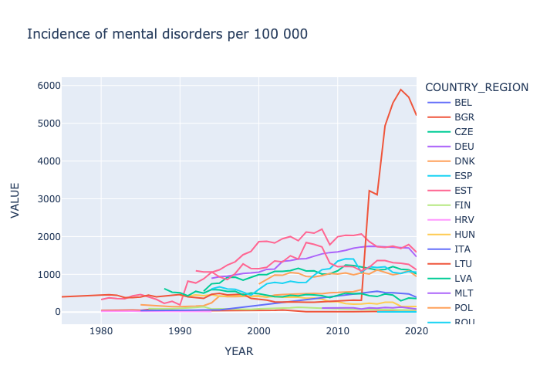
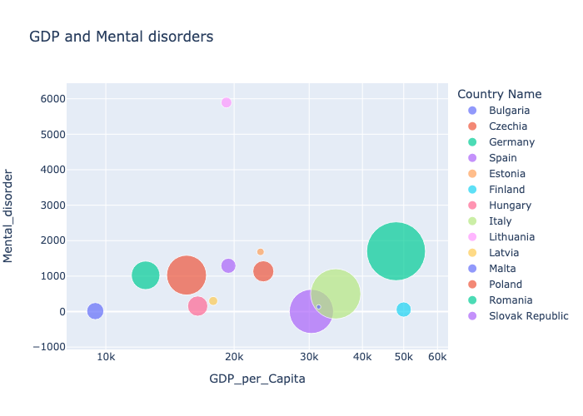
MENTAL HEALTH IN EUROPEAN COUNTRIES
Q. What is the trend of mental health disorder in EU?
H: The prevalence of mental health disorders in the EU is increasing over time.
Q. Which EU country has the highest rate of mental health disorders?
H: Higher income countries tend to have a lower prevalence of mental health disorders.
INSIGHTS
The incidence of mental disorders in european countries has generally increased over time
There is no clear linear relationship between GDP and the rate of mental health disorder

Slide 7
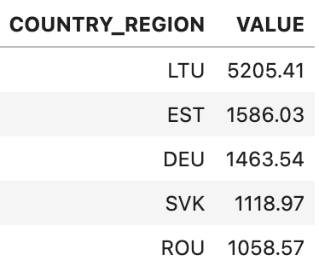
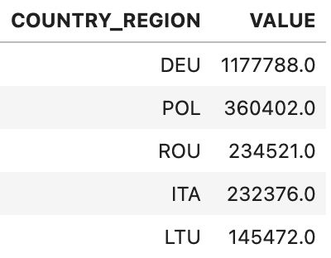


MENTAL HEALTH IN EUROPEAN COUNTRIES
Q. What is the trend of mental health disorder in EU?
Incidence of mental disorders per 100 000
Number of new cases of mental disorders
H: The prevalence of mental health disorders in the EU is increasing over time.
Q. Which EU country has the highest rate of mental health disorders?
H: Higher income countries tend to have a lower prevalence of mental health disorders.
INSIGHTS
The incidence of mental disorders in european countries has generally increased over time
There is no clear linear relationship between GDP and the rate of mental health disorder
Although Lithuania has the highest rates of mental disorders, Germany has the highest absolute number of new cases.

Slide 8
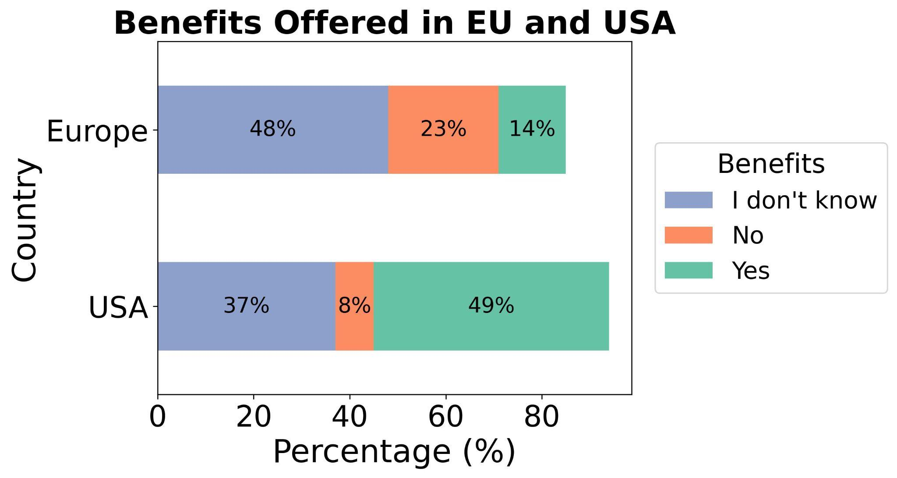
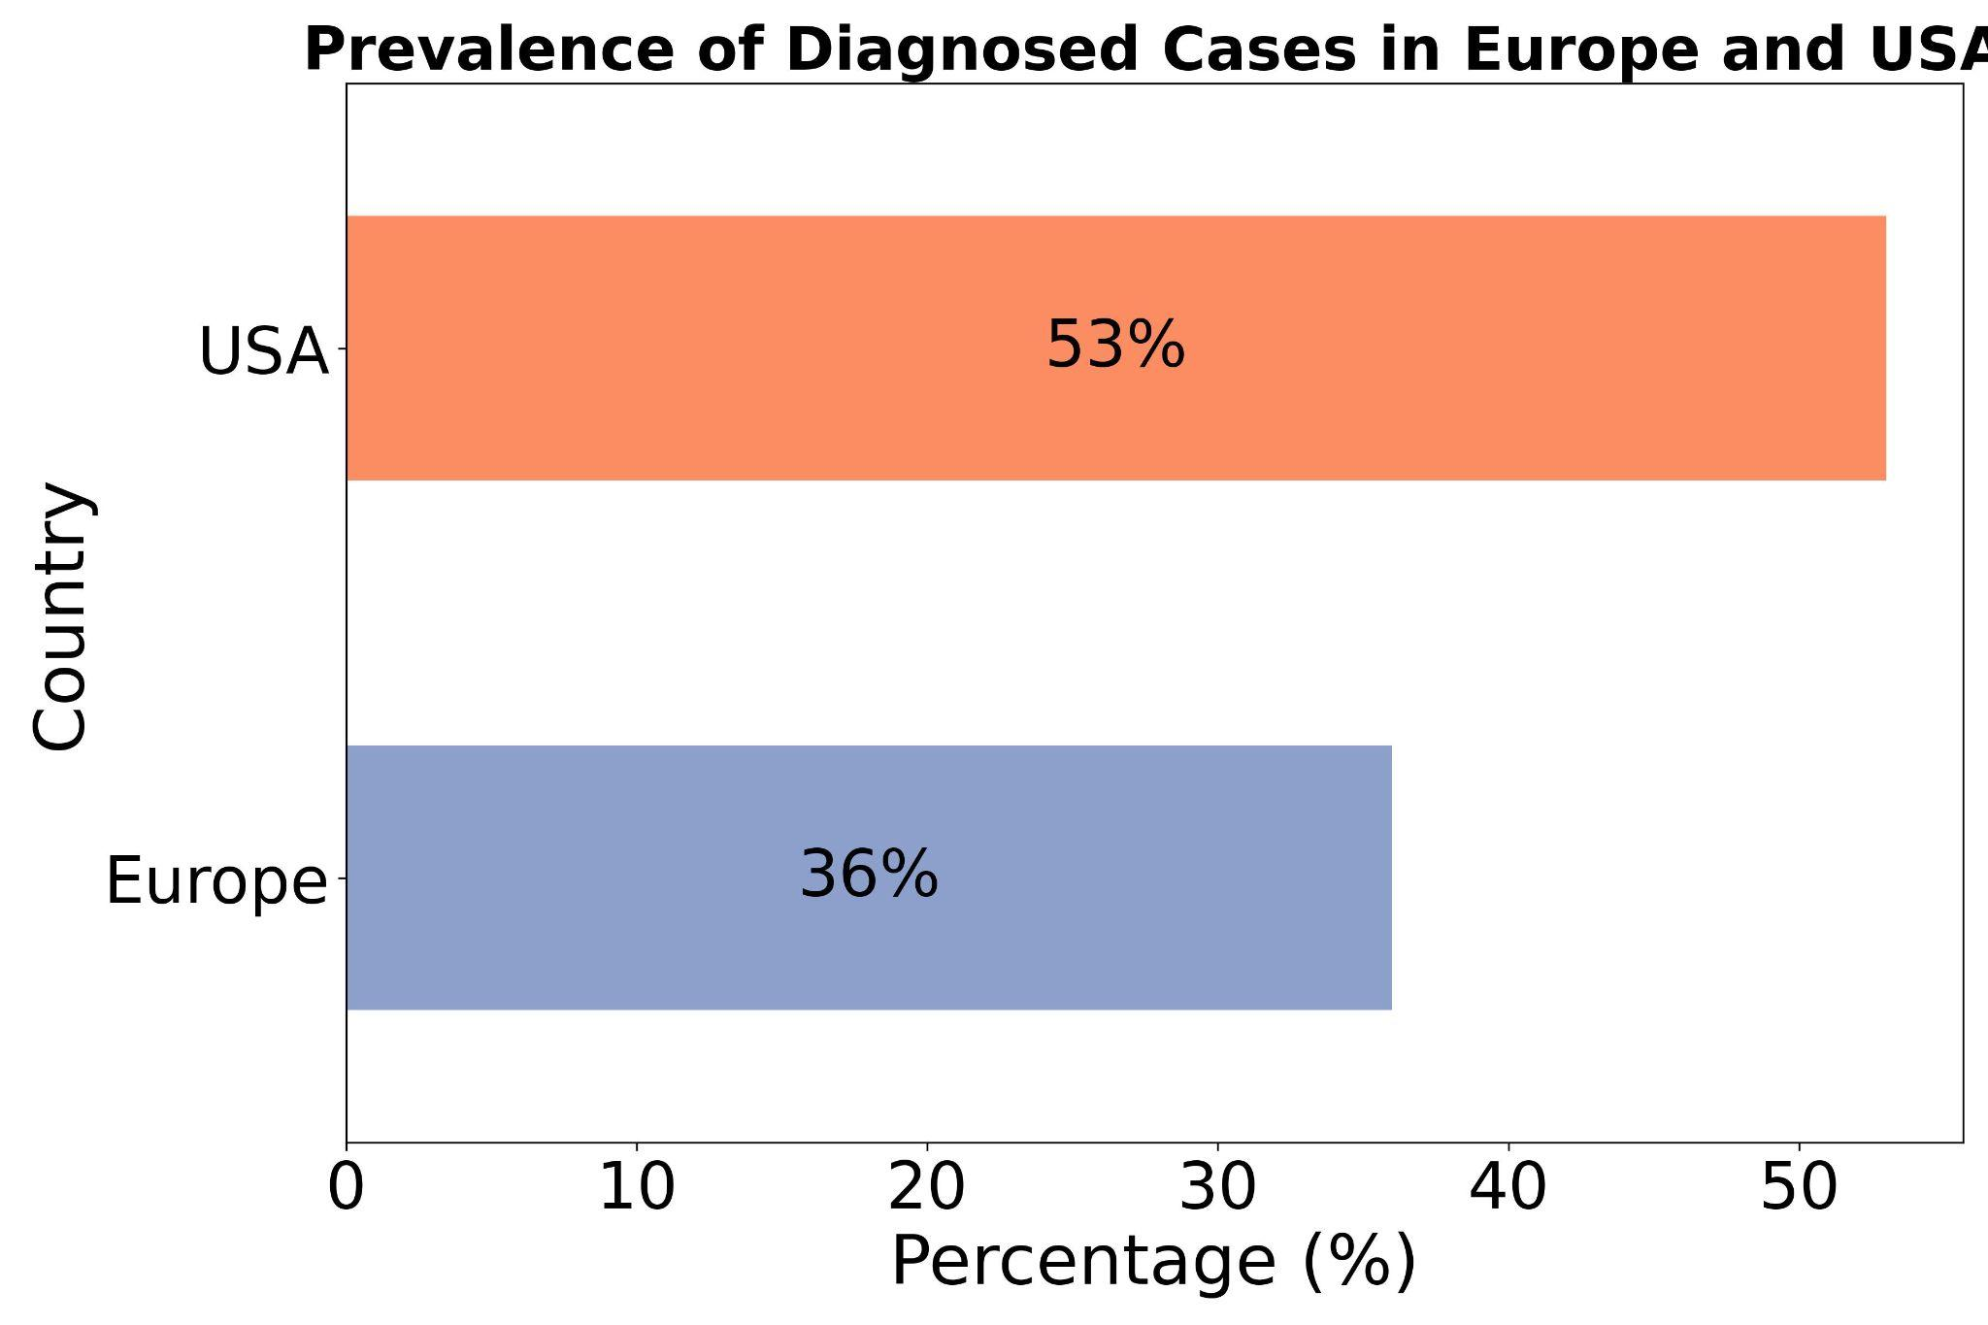
MENTAL HEALTH IN TECH INDUSTRY
Q. What is the prevalence of diagnosed cases between EU and USA?
Q. Do companies offer mental health benefits?
H: There are more diagnosed cases in the US
H: EU companies offer more benefits to cover mental health issues
Prevalence of Diagnosed Cases in EU and USA
INSIGHTS
The % of work-related diagnosed mental health issues is higher in the US than in EU → worse life-balance conditions in US?
Mental health benefits are offered more by US companies compared to Europe → EU is a better target?

Slide 9
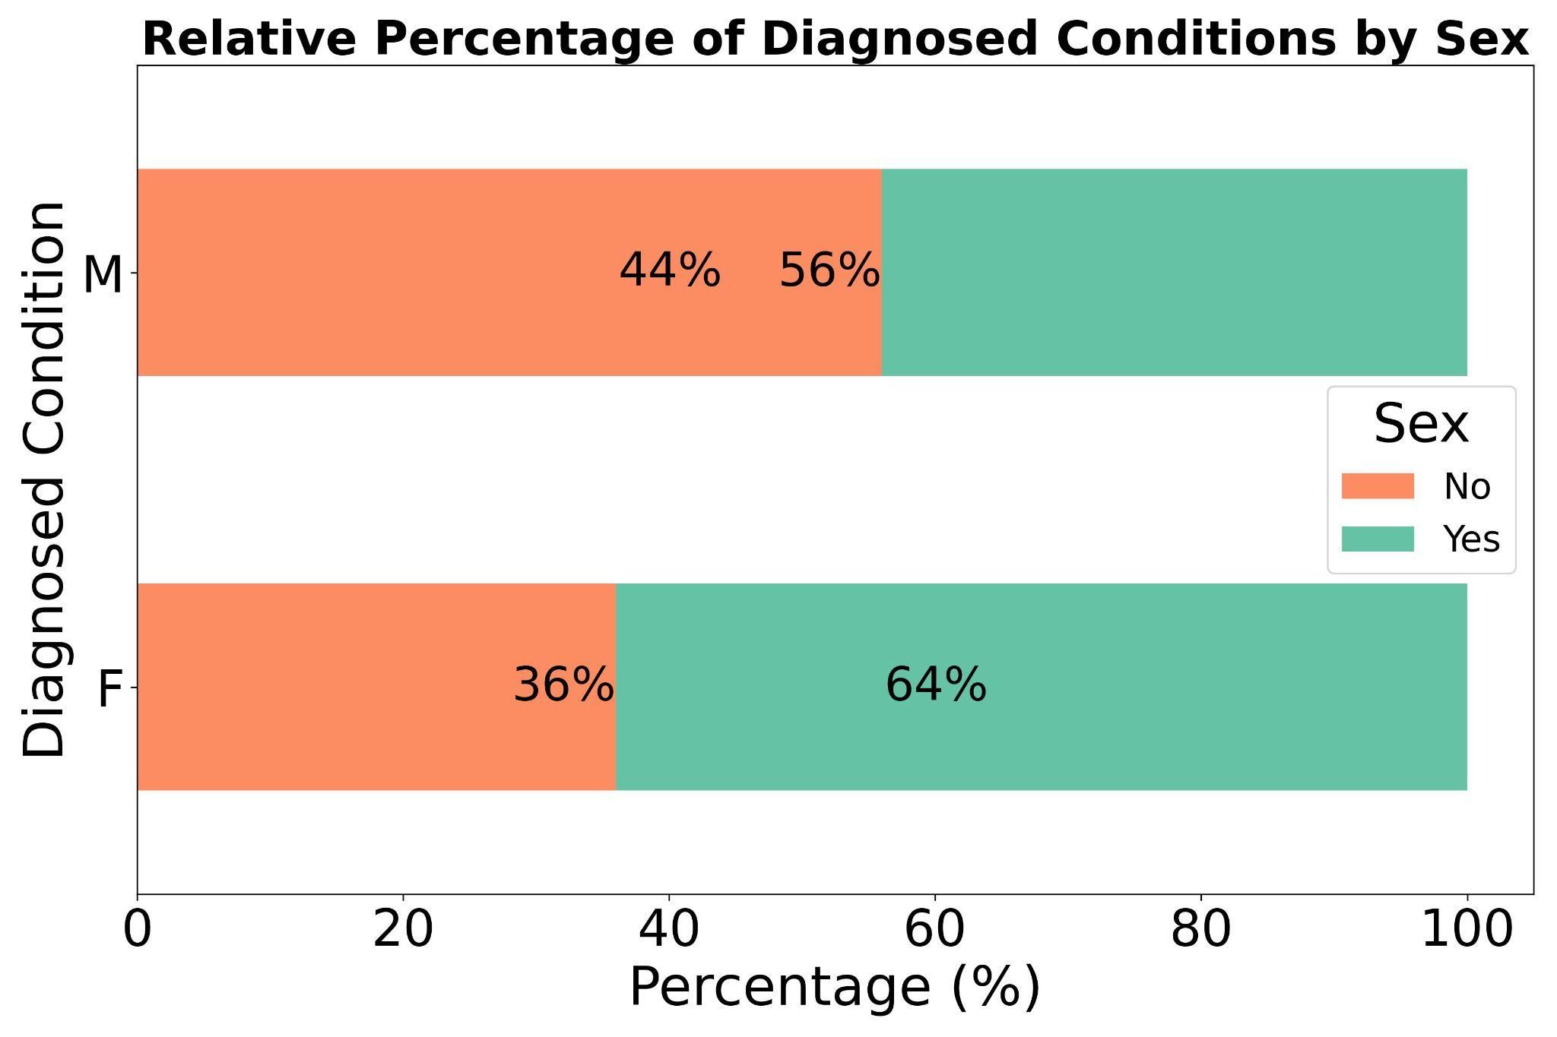
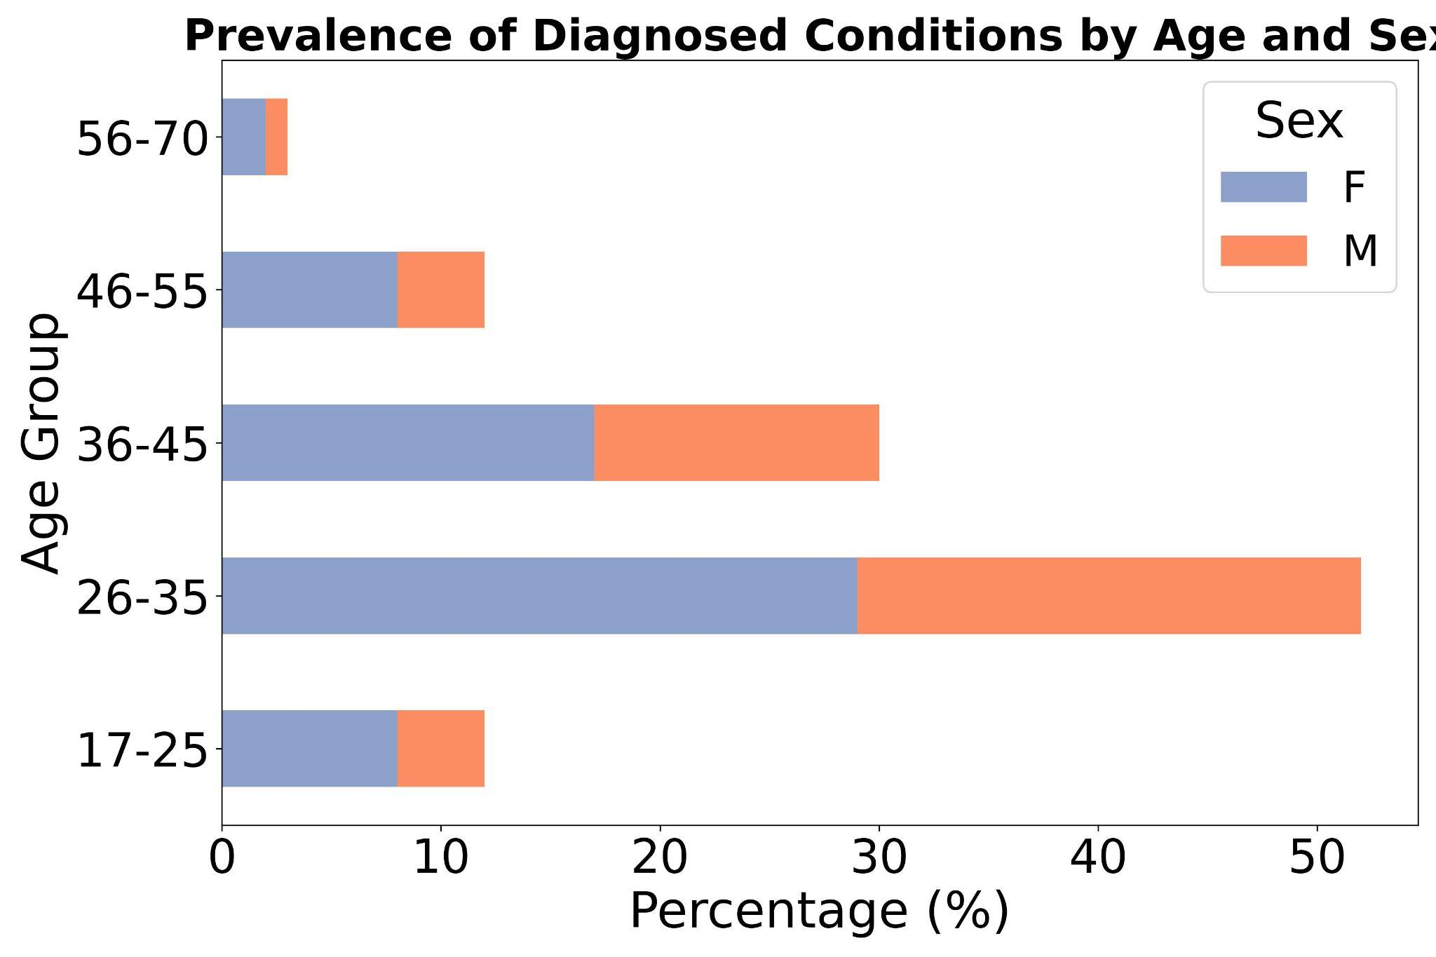
MENTAL HEALTH IN TECH INDUSTRY
Q. Are women and men equally affected in the workplace?
Q. What is the most affected age range?
H: Women are more affected
H: Younger people are most affected
Prevalence of Diagnosed Conditions by Sex
Prevalence of Diagnosed Conditions by Age and Sex
1%
2%
56%
8%
4%
17%
13%
29%
23%
8%
4%
INSIGHTS
% of work-related diagnosed mental health issues is higher for women than men
For both men and women the most affected age is between 26 and 35 years old → target population?

Slide 10
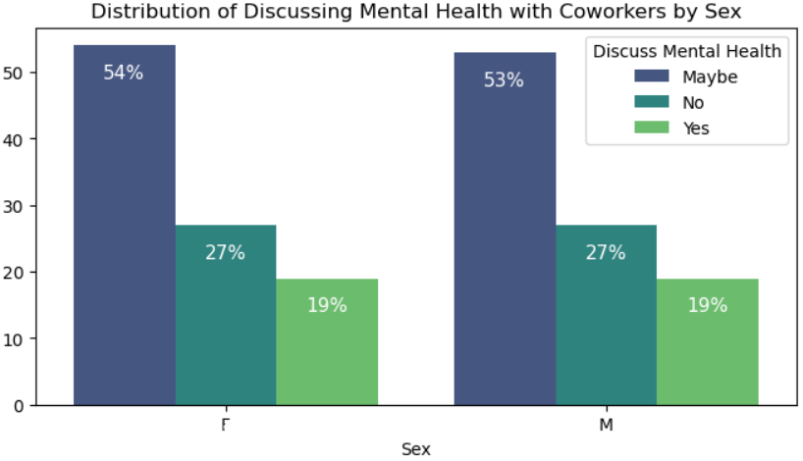
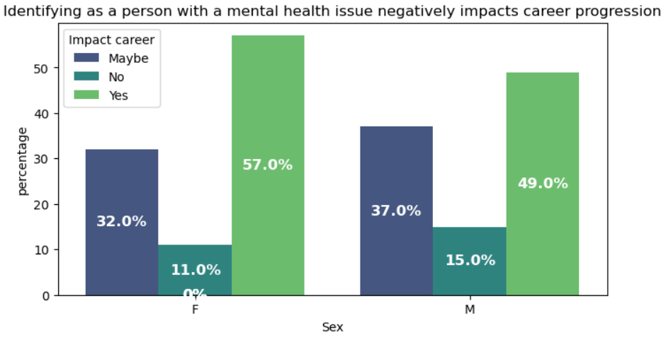
MENTAL HEALTH IN TECH INDUSTRY
Q. Are there significant gender differences in how mental health issues are perceived and discussed in the workplace?
H:Employees who believe discussing mental health issues will negatively impact their career are less likely to seek help within the organization.
INSIGHTS
In this specific context, there is a level of equality in how mental health issues are perceived and discussed among different genders.
This hypothesis suggests that fear of career repercussions discourages employees from using organizational mental health resources.

Slide 11
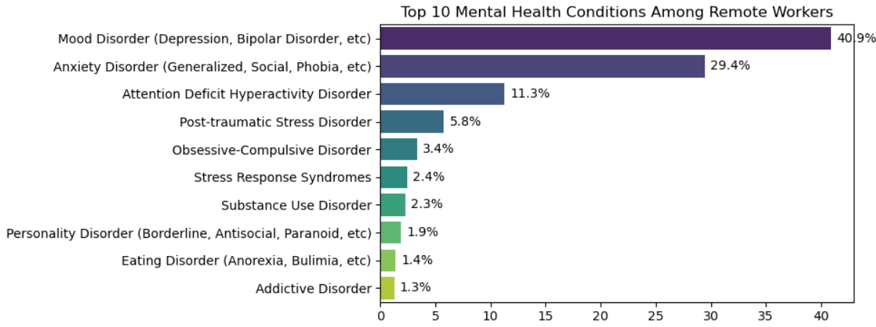
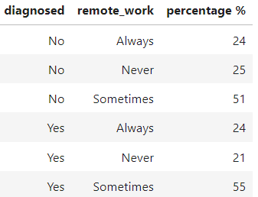
MENTAL HEALTH IN TECH INDUSTRY
Q. Is remote working bad for mental health?
INSIGHTS
The isolation experienced by remote workers does not necessarily contribute to depressive symptoms.
There isn’t a correlation between the number of hours worked remotely and the likelihood of experiencing anxiety.
H: Remote workers who have less face-to-face interaction with colleagues and friends are more likely to experience depressive symptoms.

Slide 12
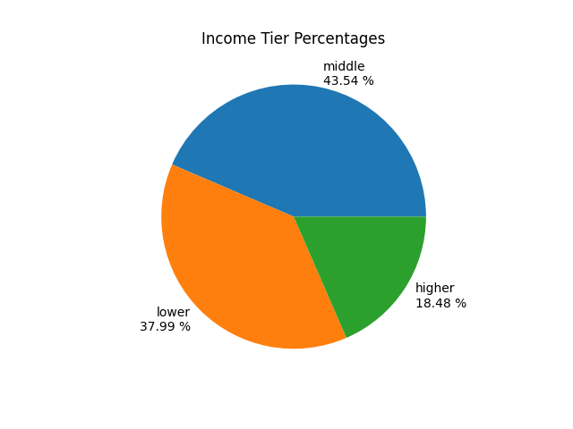
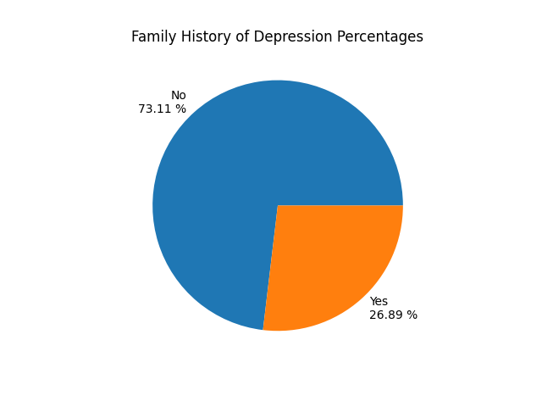
MENTAL HEALTH AND SOCIO-ECONOMIC ASPECT (Depression)
Q. Is there a disparity by income?
H: People from low and middle class are more affected than people with a higher income
Q. Could it be a hereditary?
H: If there is a correlation with Income, could it be hereditary as well.
INSIGHTS
Data confirms that higher Income classes are less affected, what could be the reasons?
Approximately 73% didn’t have family history of the disease, so there musn’t be a hereditary condition.

Slide 13
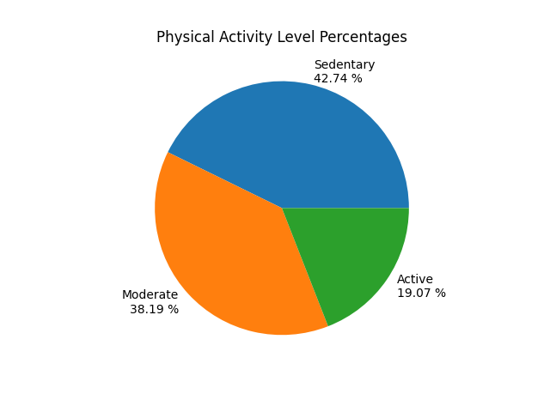
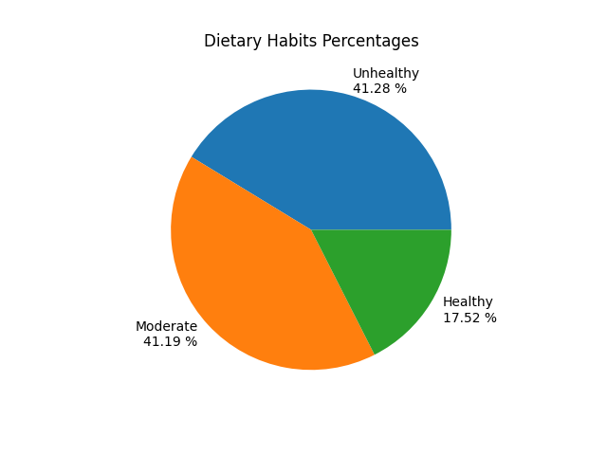
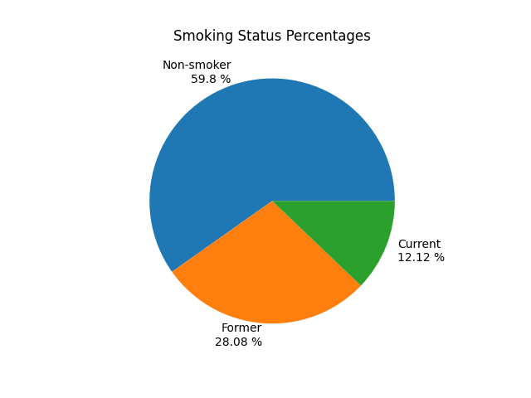
MENTAL HEALTH AND PHYSICAL HEALTH (Depression)
Q. Could physical health impact mental health?
H: A sedentary lifestyle impact our mental health
H: Dietary habits have impact in mental health
H: Smoking habit may have a impact in depression

Slide 14



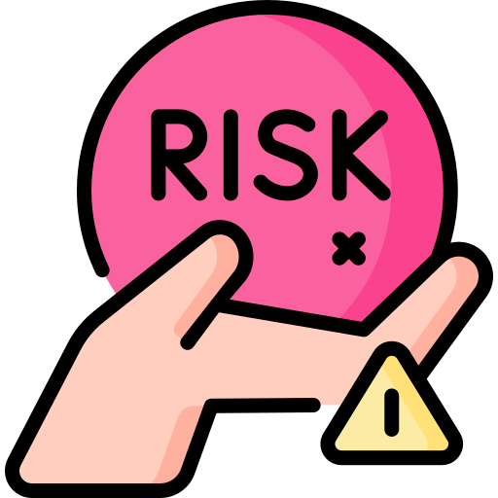
TEAMWORK & PROJECT MANAGEMENT
Workflow Plan
Strength
Future Improvement
Risk Management
The workflow plan was followed, but needed to add tasks due to our inexperience.
The task distribution was effective, each one of us contribute for one part of the project.
A clearer understanding of the tasks could enable further subdivision, making project management easier day by day.
We set an early deadline to allow for any delays, ensuring we stayed on track.

Slide 15


Major Obstacle
Lessons Learned
Environment setup on the notebooks folder leads to having two UV environments and need to create a new one
Cleaning Mental Health in Tech Survey dataset
The disparity between men and women in the Mental Health in Tech Survey dataset required normalization of the results.
Collaboration work using GitHub
Carefully assess and interpret the data before reaching any conclusions
Managing the time spent on different phases of the project, especially data cleaning, which often takes up more time than expected.

Slide 16
INSIGHTS SUMMARY
Mental health trends in Europe:
  The incidence of mental disorders in european countries has generally increased over time
  Higher country wealth does not directly correlate with lower mental health disorder rate
Mental health in the tech workplace:
  European companies seem to offer less mental health coverage compared to the US
  Higher rates of diagnosis between 26 and 35 years, with women more affected than men
  Fear of career repercussions discourages employees from using organizational mental health resources
  There is no correlation between working remotely and the chance of experiencing mental health issues
Mental health and socio-economic aspect:
  Higher income individuals appear to be less affected
  While genetics does not seem to play a crucial role, healthy habits have a positive impact on mental health

Slide 17
CONCLUSIONS
Strategic Market Focus: Target countries like Lithuania and Germany, where mental health challenges are rising, indicating a potential demand for workplace mental health services.
Company Size Targeting: Position services to appeal to large enterprises that can afford comprehensive mental health programs, highlighting the benefits of improved employee well-being.
Tailored Service Offerings: Design services that address the specific needs of young employees particularly focusing on women, who are more likely to be affected.
Employer Engagement: Emphasize the importance of creating a supportive workplace culture where employees feel safe using mental health resources without fear of career repercussions.
Evidence-Based Approach: Develop programs that integrate wellness and counseling, making them more attractive to employers and effective for employees.

Slide 18
WellSpace
Partners
Transforming Mental Health into
Corporate Strength
THANK YOU
Aisyah Amatul Ghina | Alessia Urzi | Loredane Nery | Tiago Pedro

